Slide 1

Adaptive Joins

Slide 2
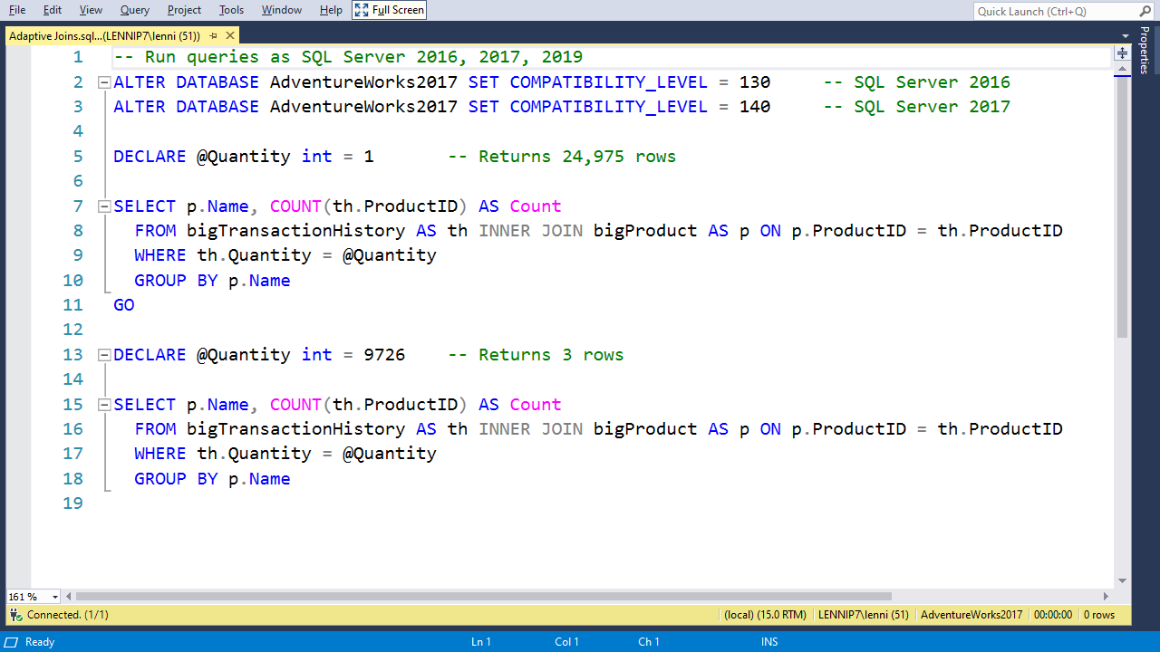

Slide 3
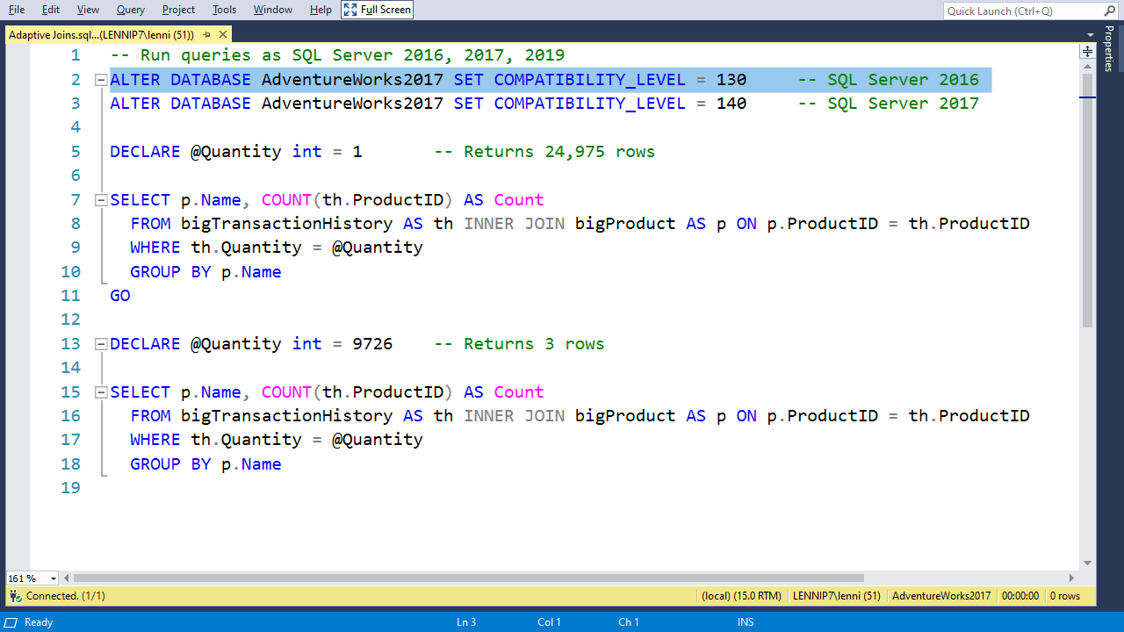

Slide 4
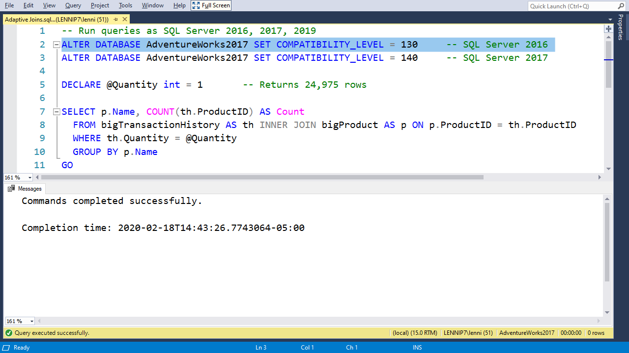

Slide 6
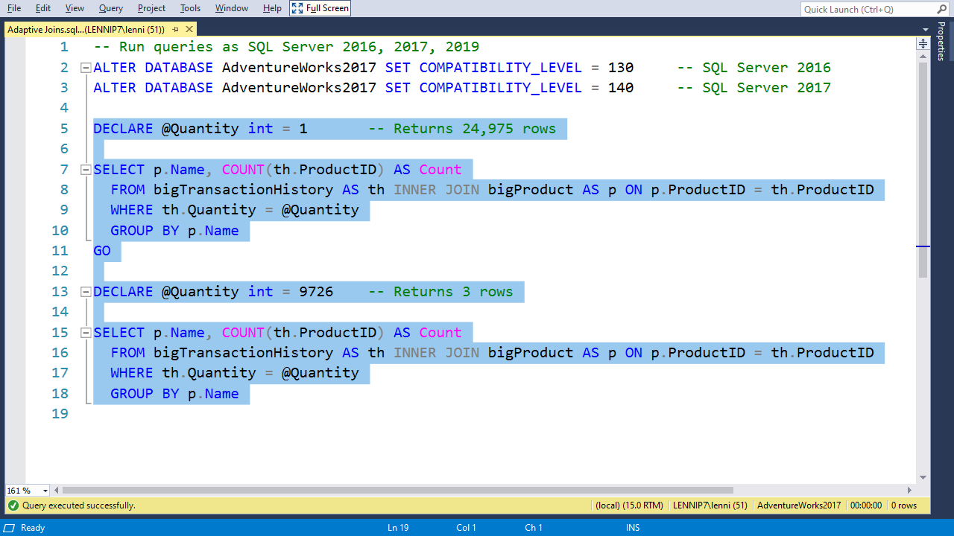

Slide 7
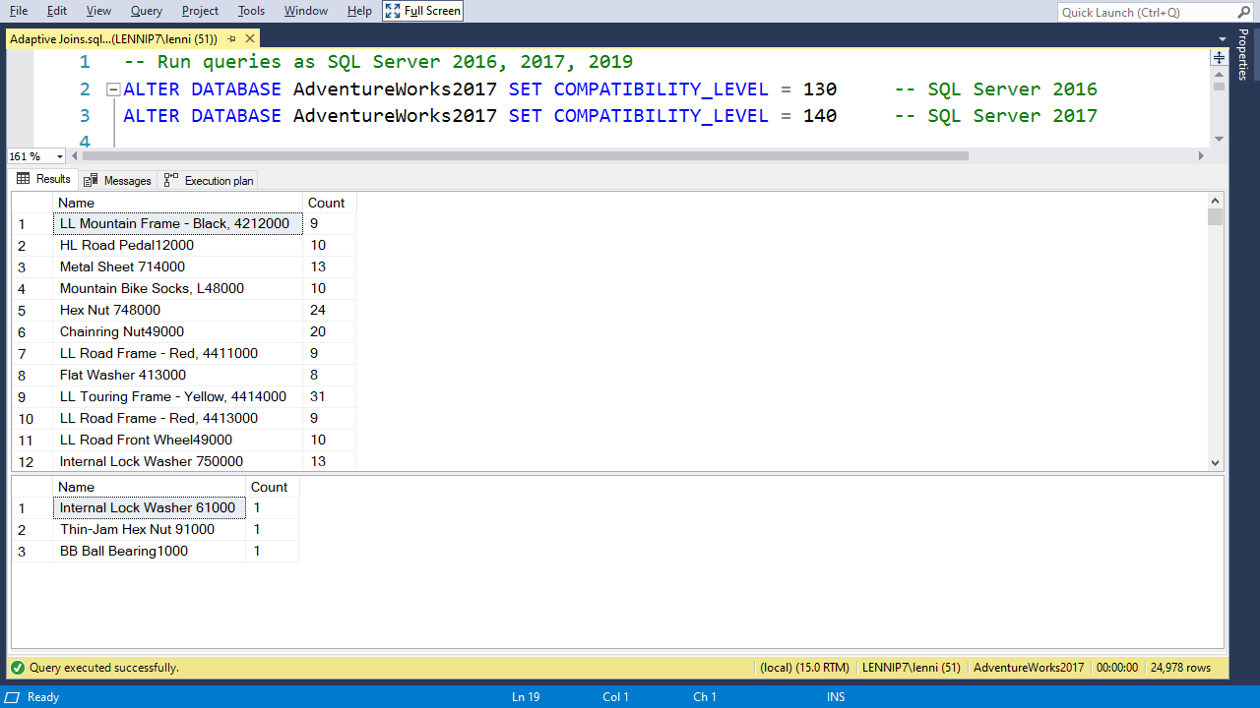

Slide 8
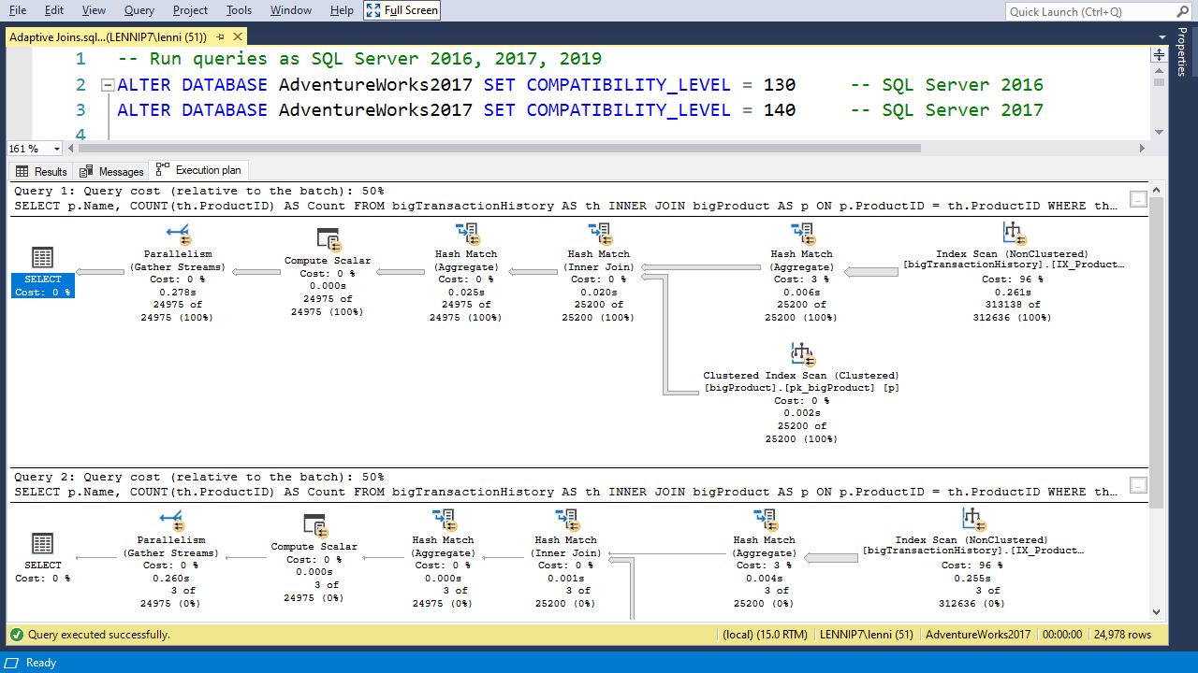

Slide 9
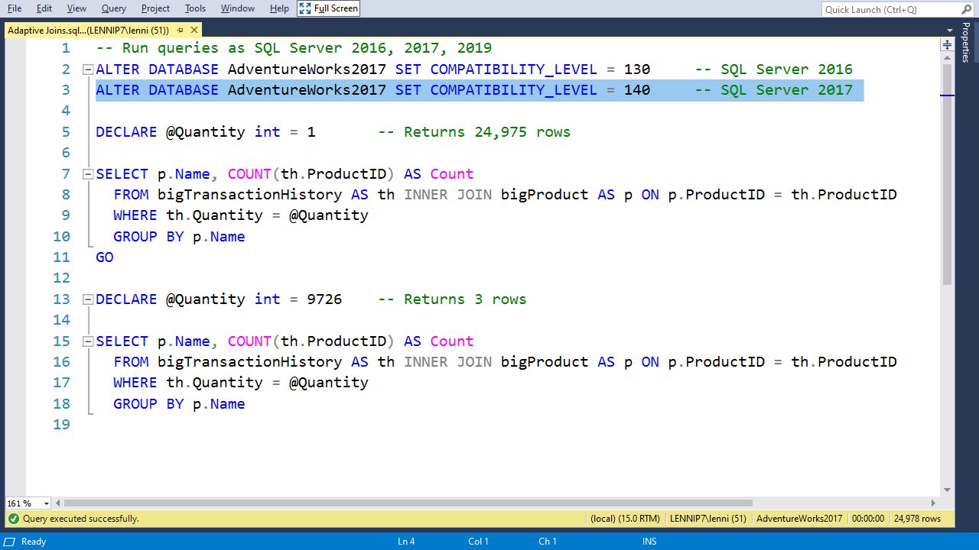

Slide 10
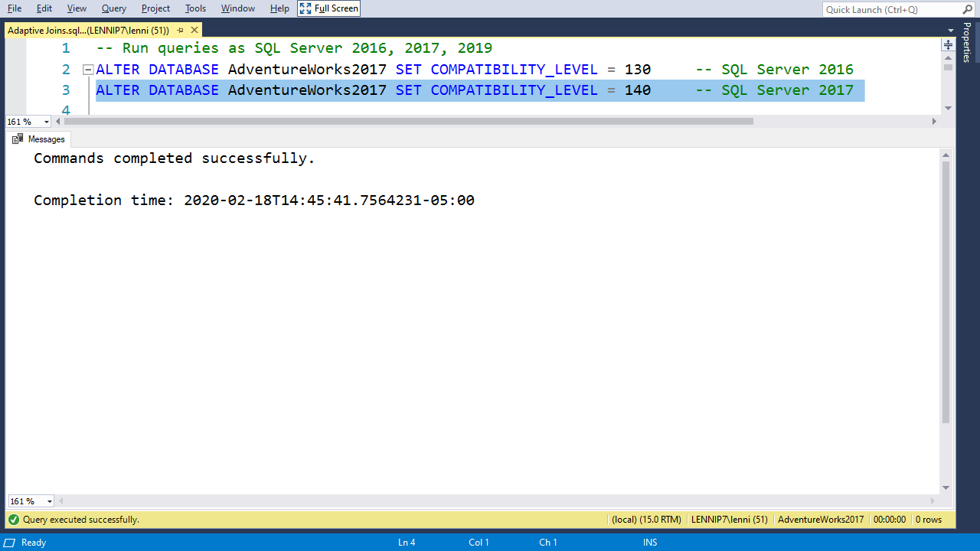

Slide 13
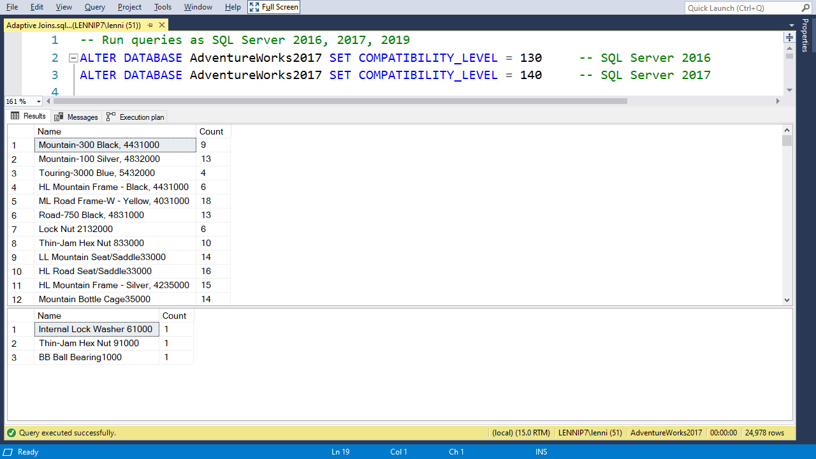

Slide 14
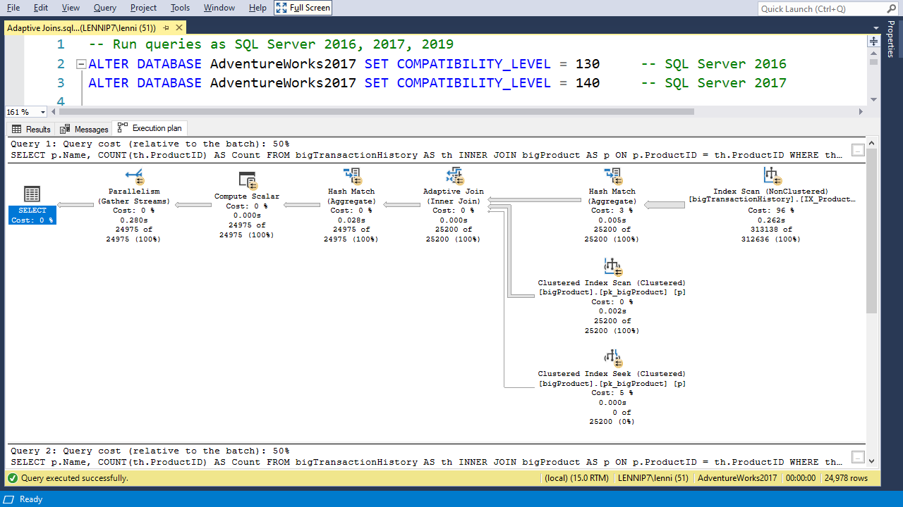

Slide 15
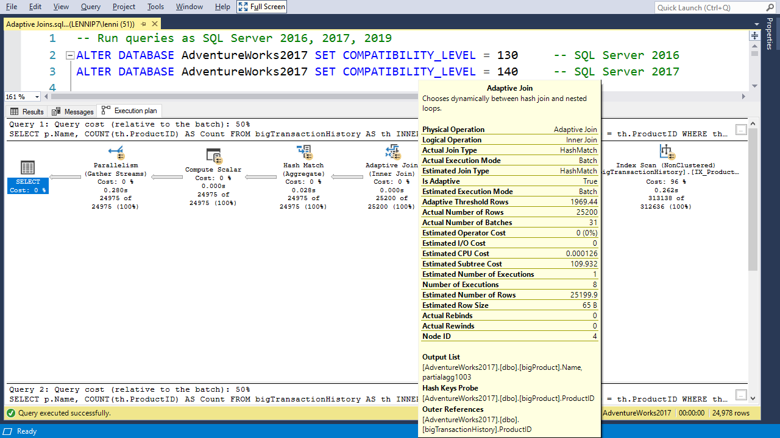

Slide 18
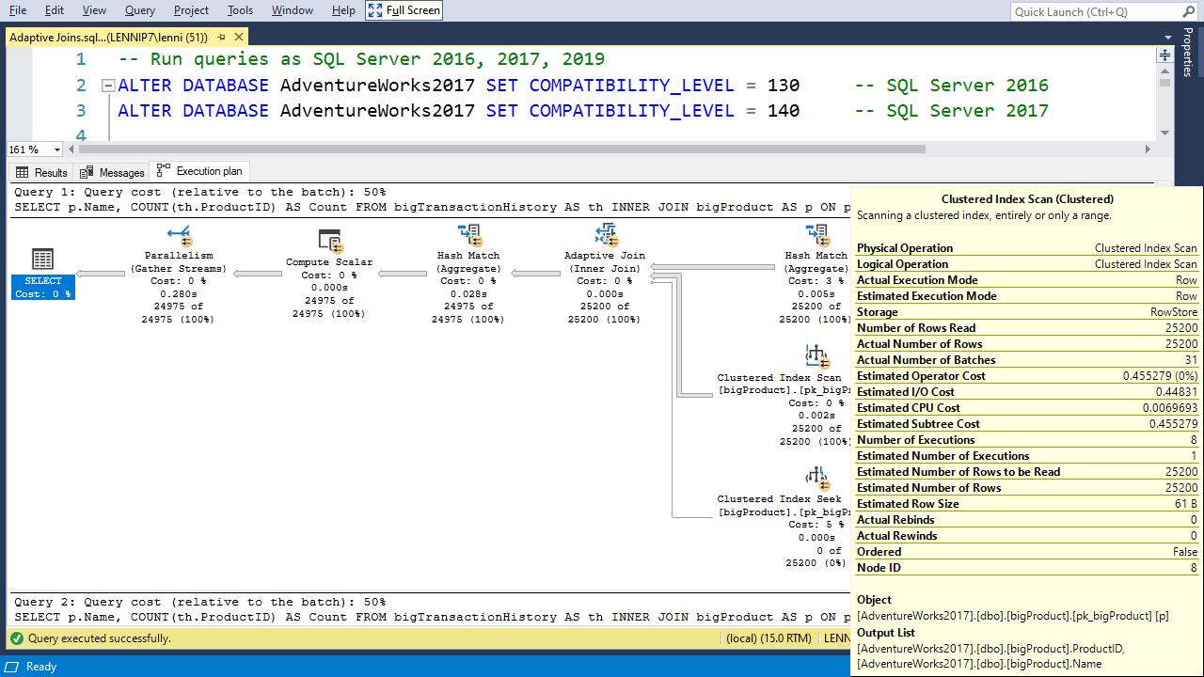

Slide 20
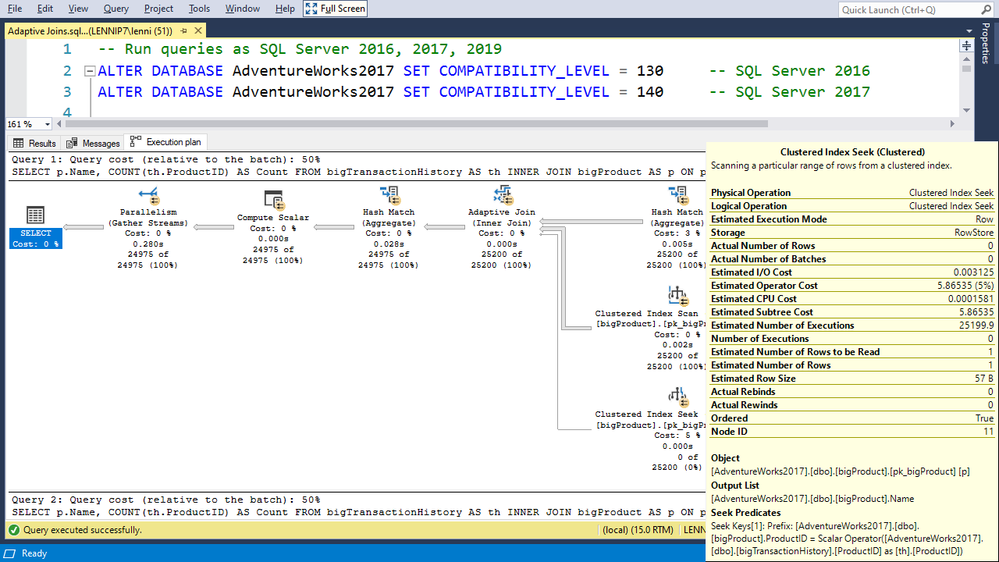

Slide 22
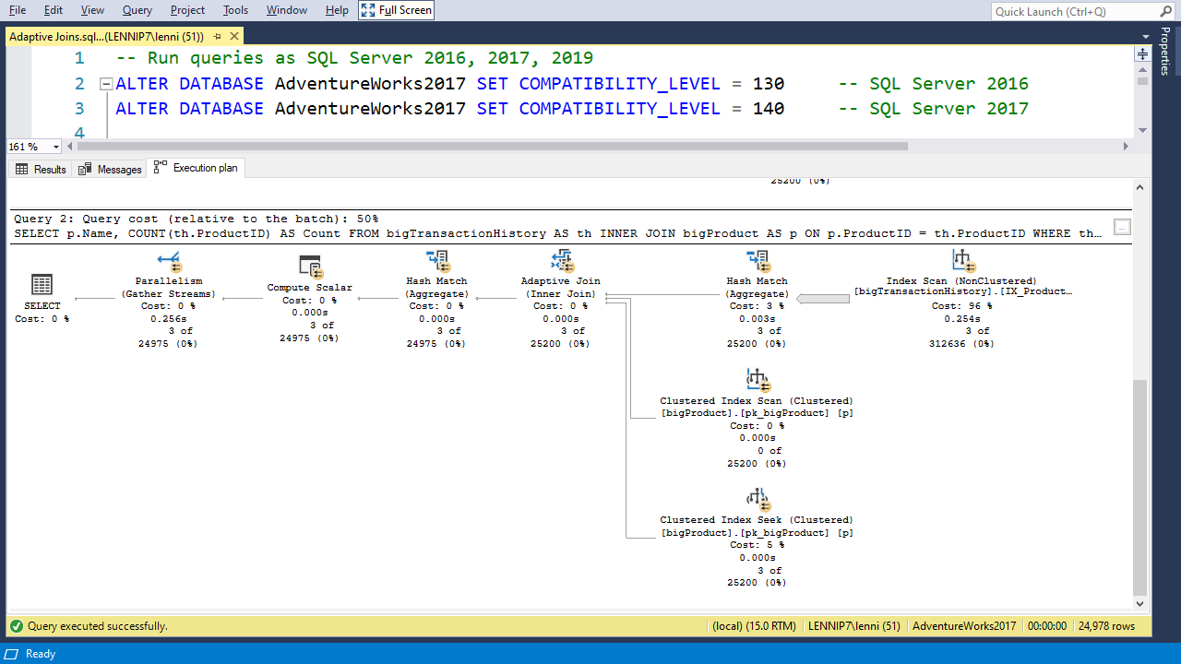

Slide 23
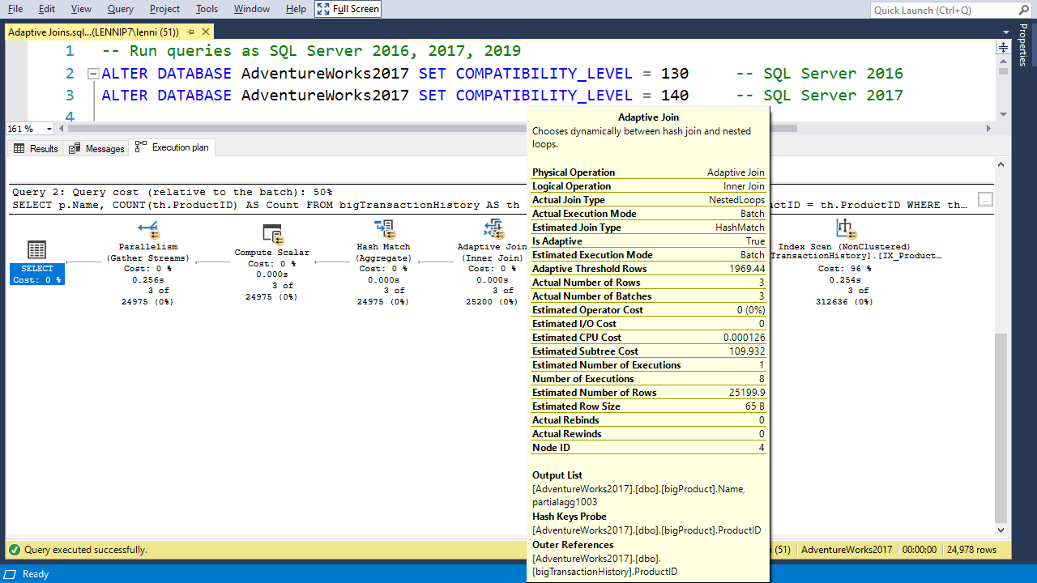

Slide 26
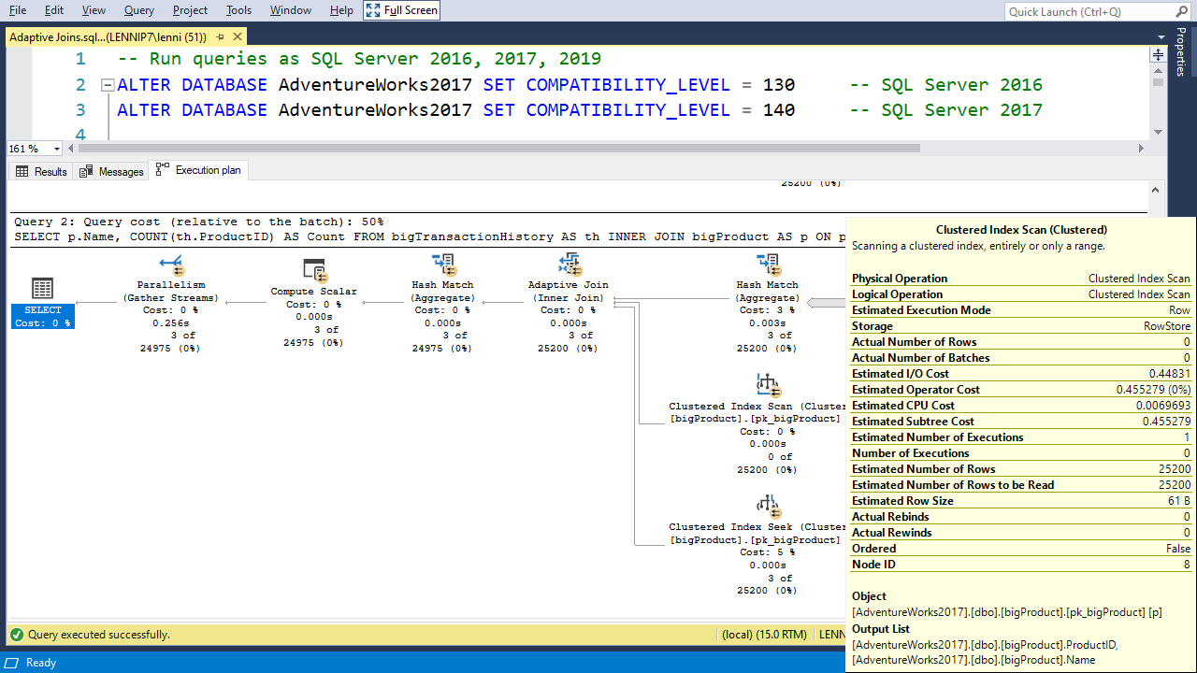

Slide 28
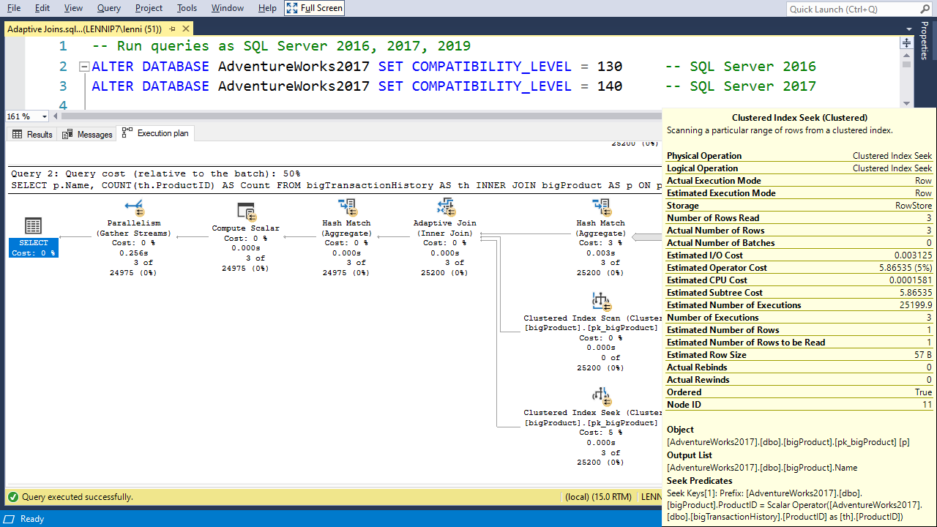

Slide 30
Notes:
More 2017
Adaptive query processing improvements
New availability groups functionality
Always Available (cross-database access)
Distributed transaction support
DTA improvements

Slide 31
Interleaved Execution

Slide 32
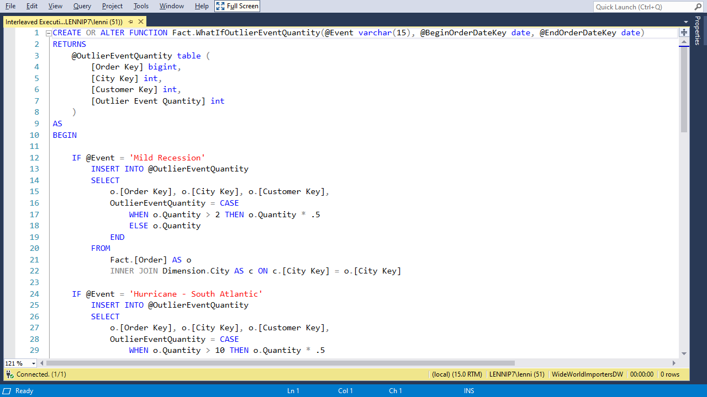

Slide 33
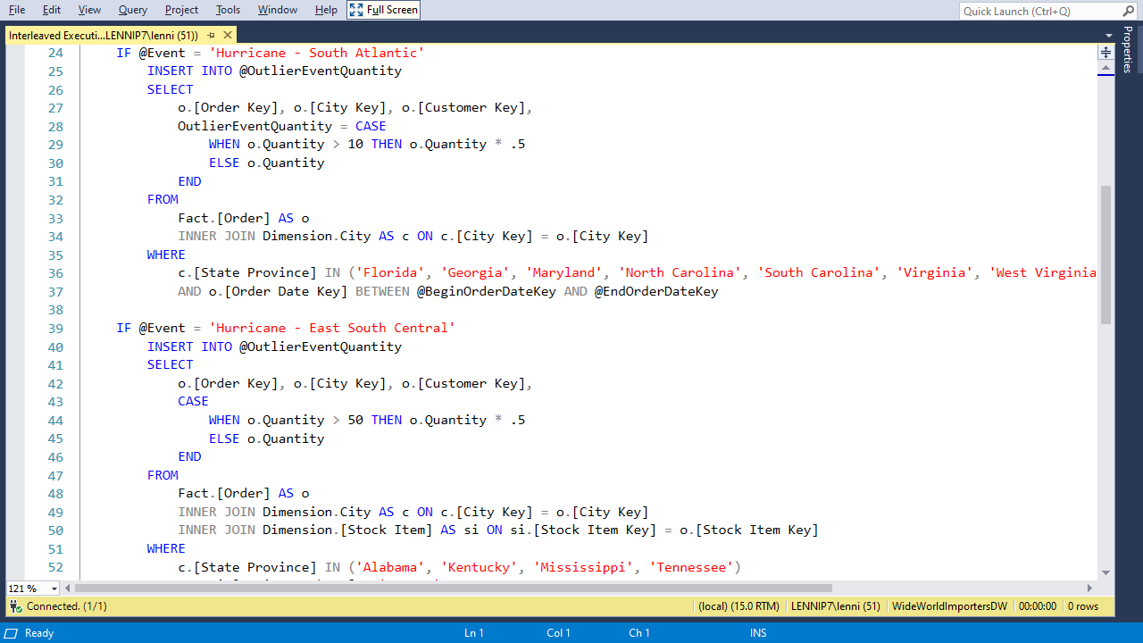

Slide 34
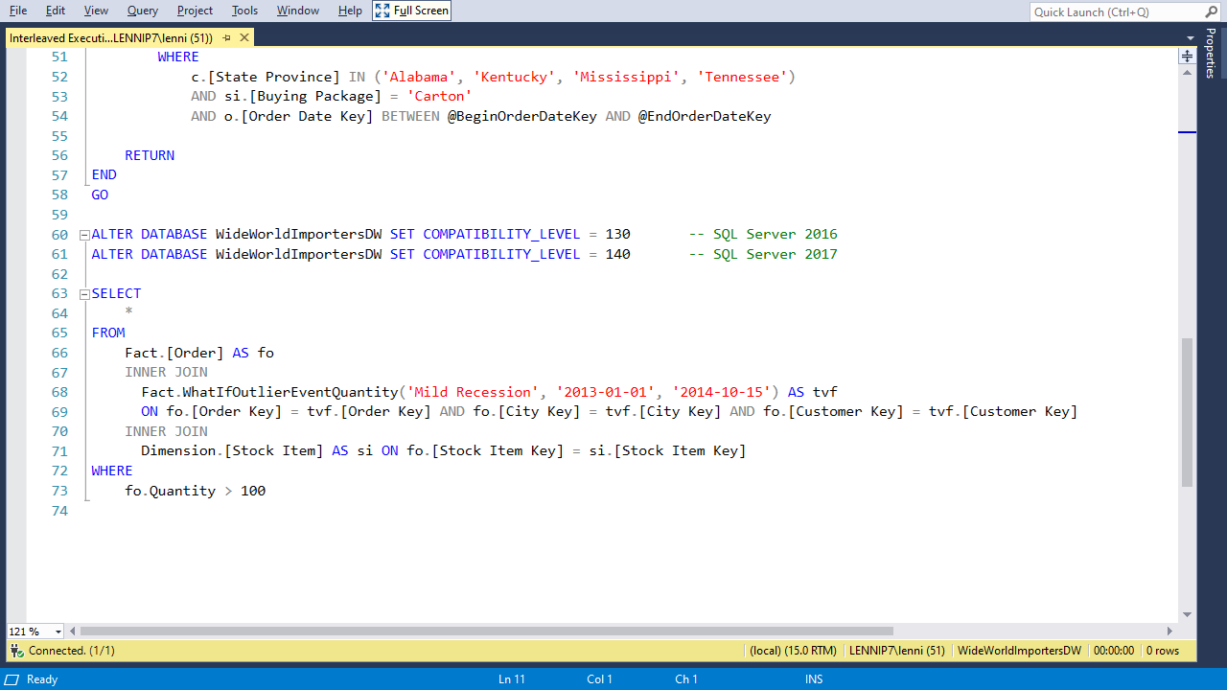

Slide 35
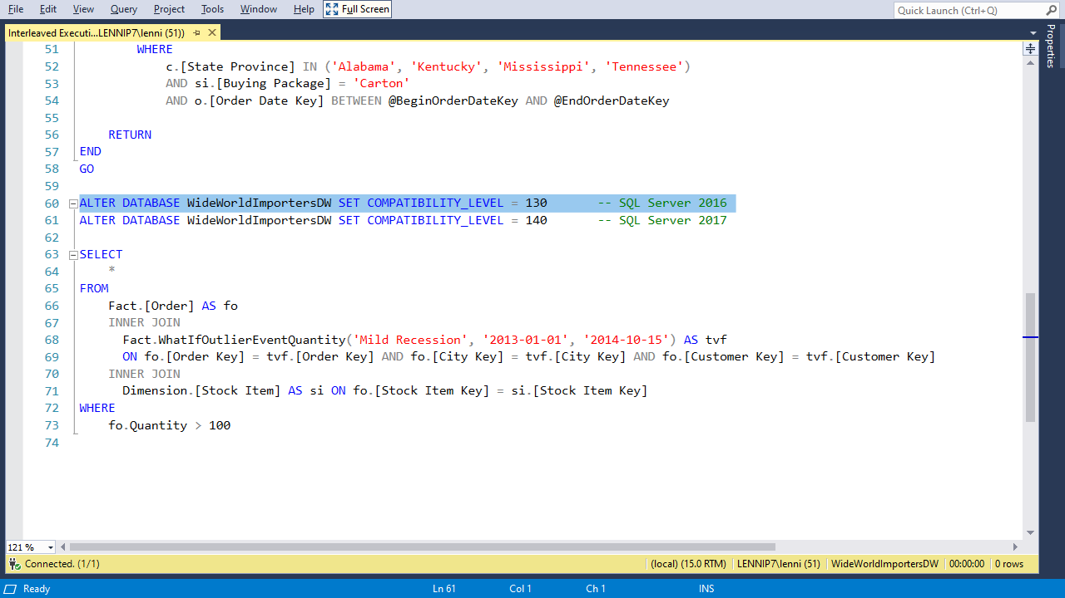

Slide 36
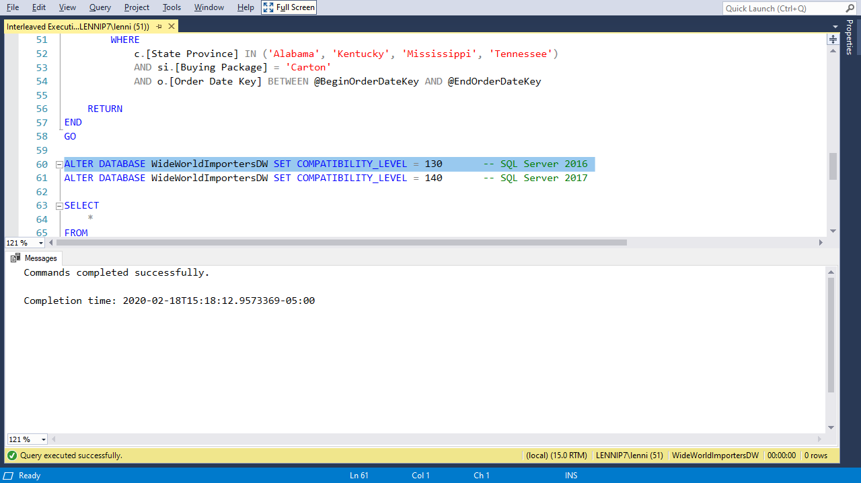

Slide 38
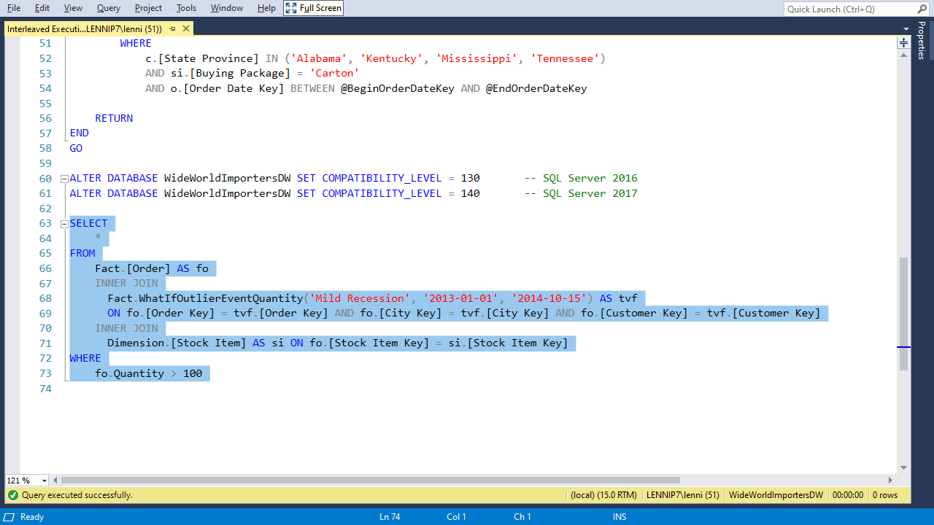

Slide 39
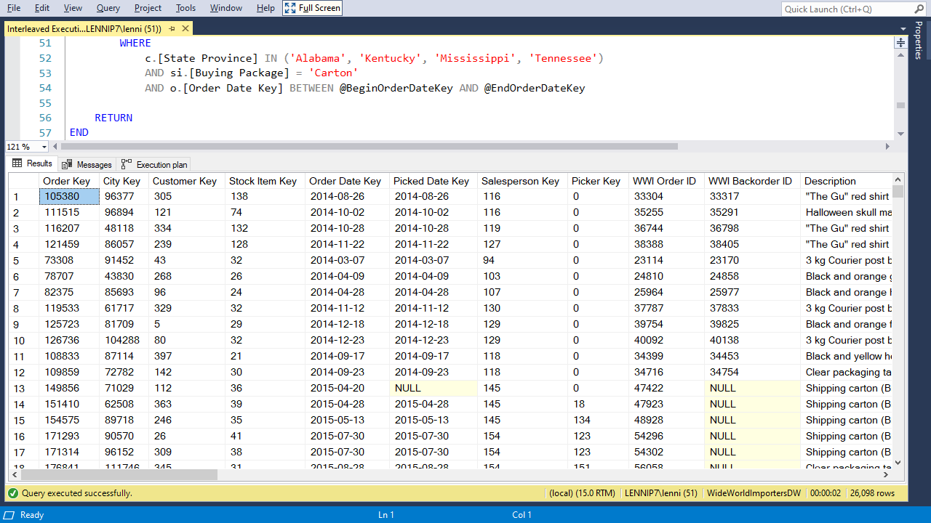

Slide 40
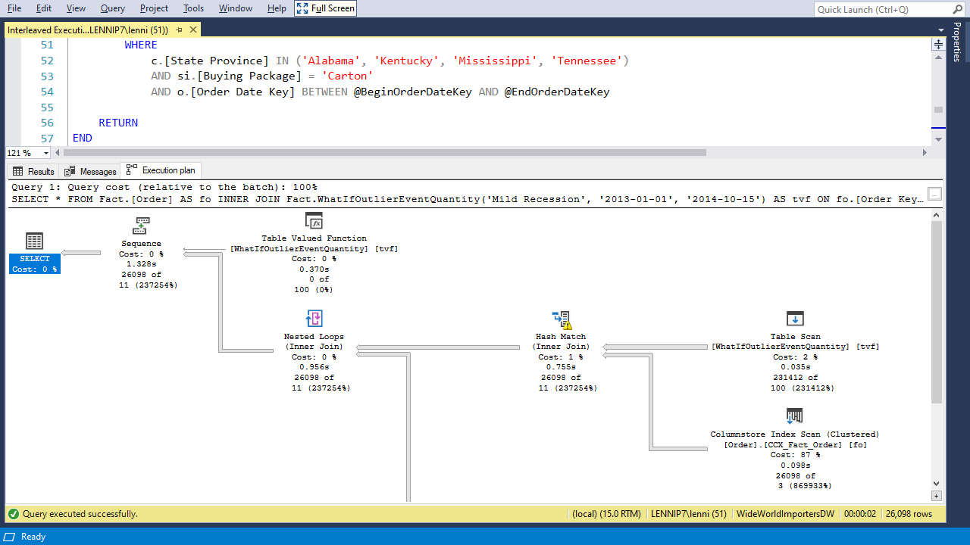

Slide 41
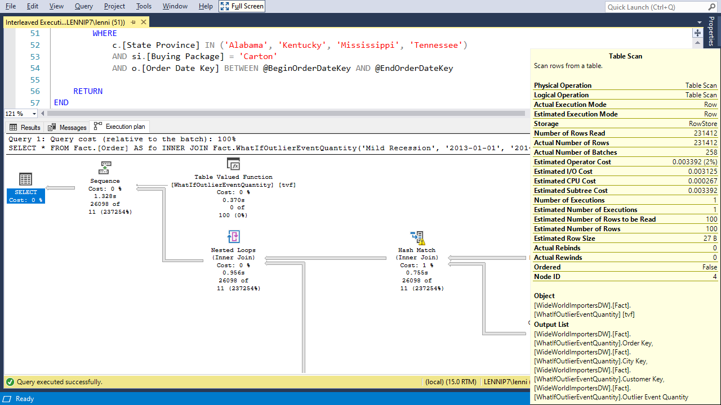

Slide 43
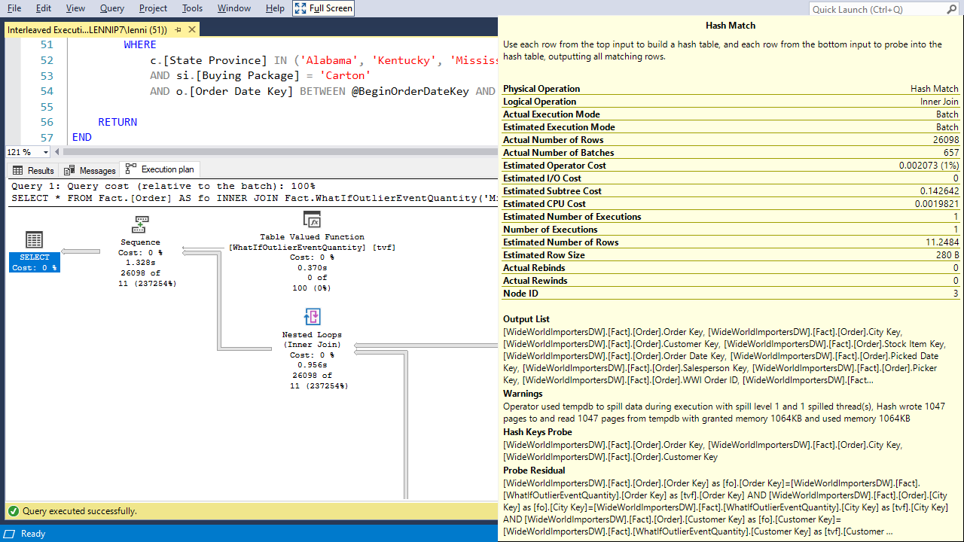

Slide 45
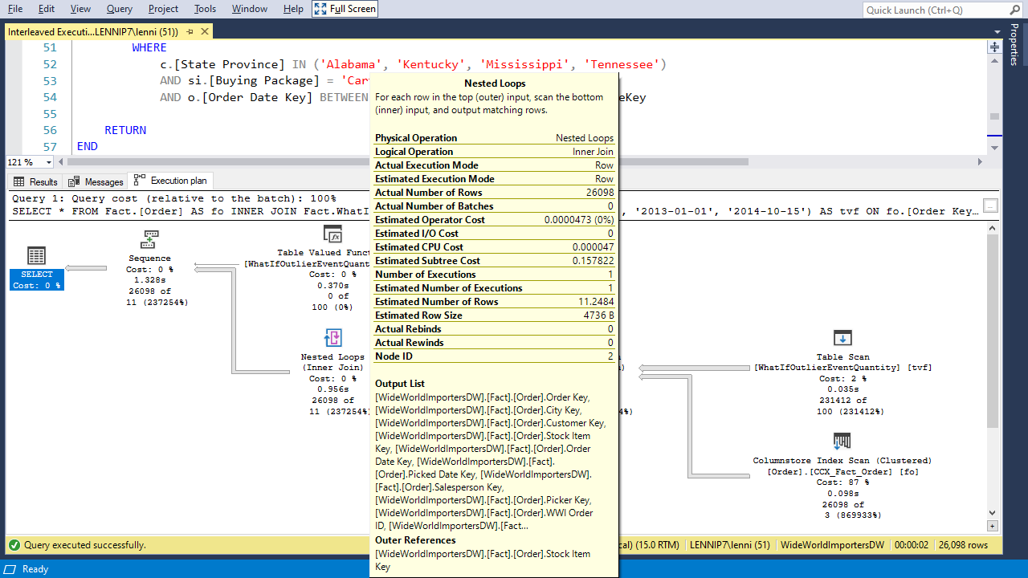

Slide 47
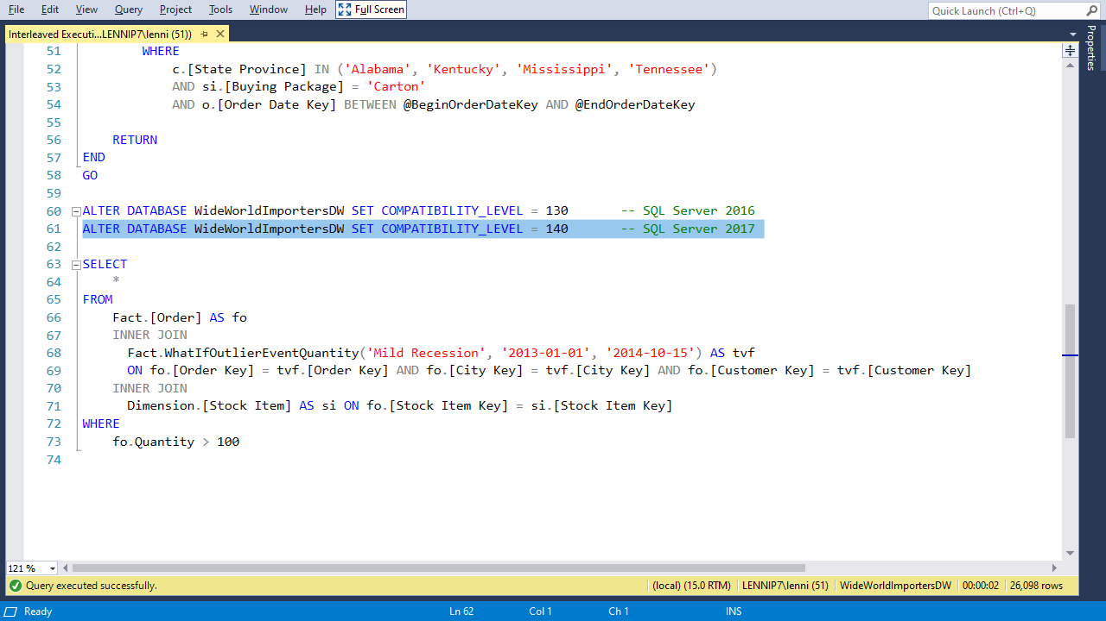

Slide 48
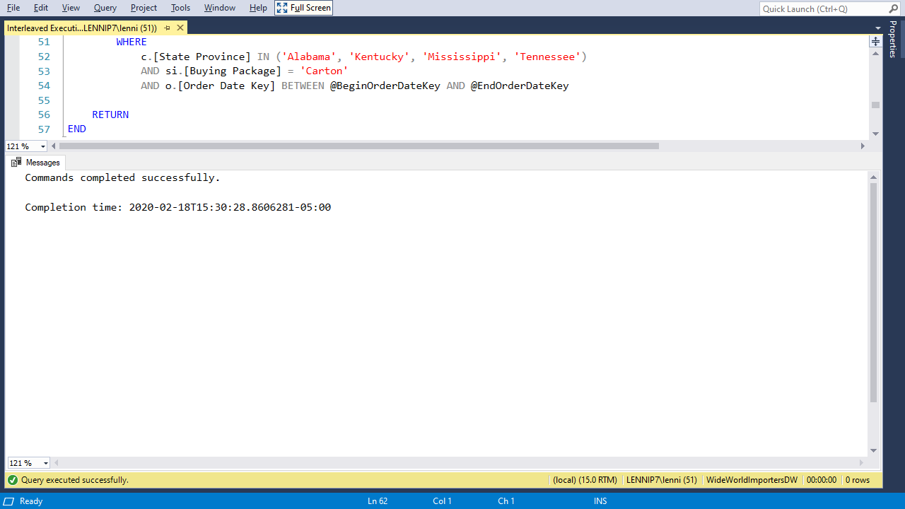

Slide 51
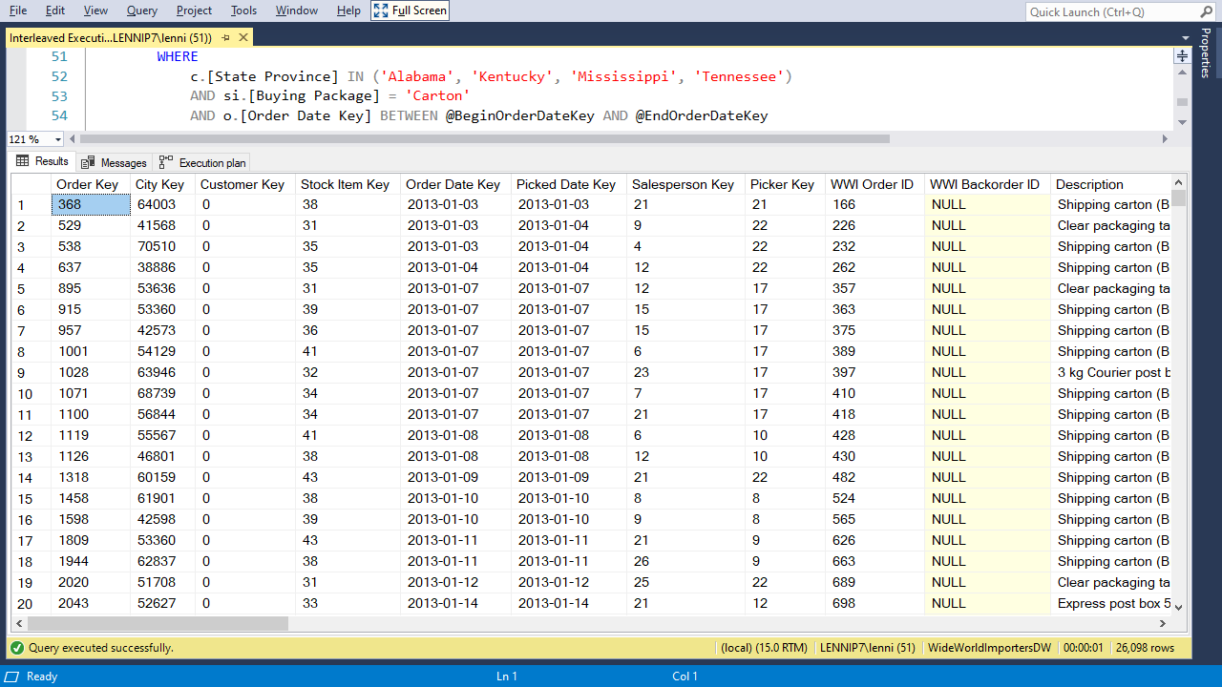

Slide 52
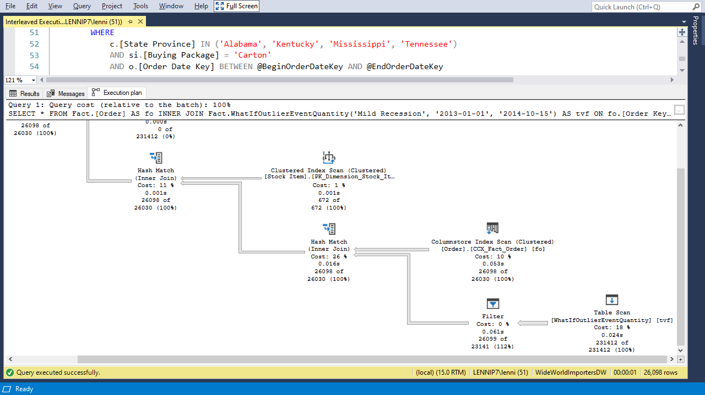

Slide 53
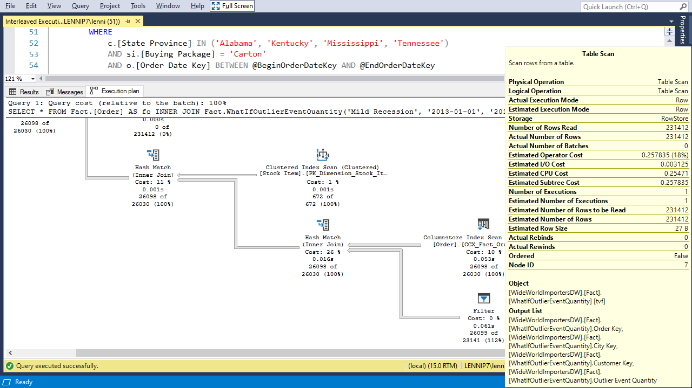

Slide 55
Notes:
More 2017
Adaptive query processing improvements
New availability groups functionality
Always Available (cross-database access)
Distributed transaction support
DTA improvements

Slide 56
Memory Grant Feedback

Slide 57
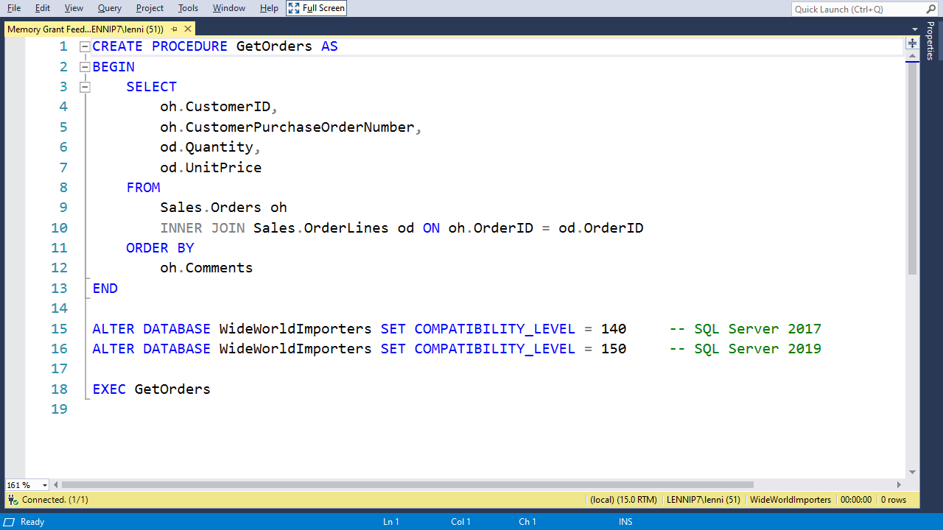

Slide 58
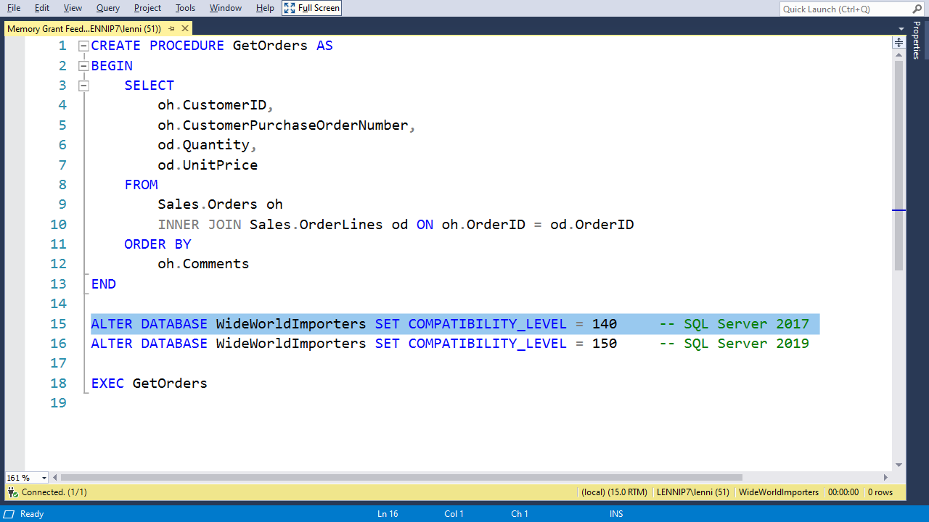

Slide 59
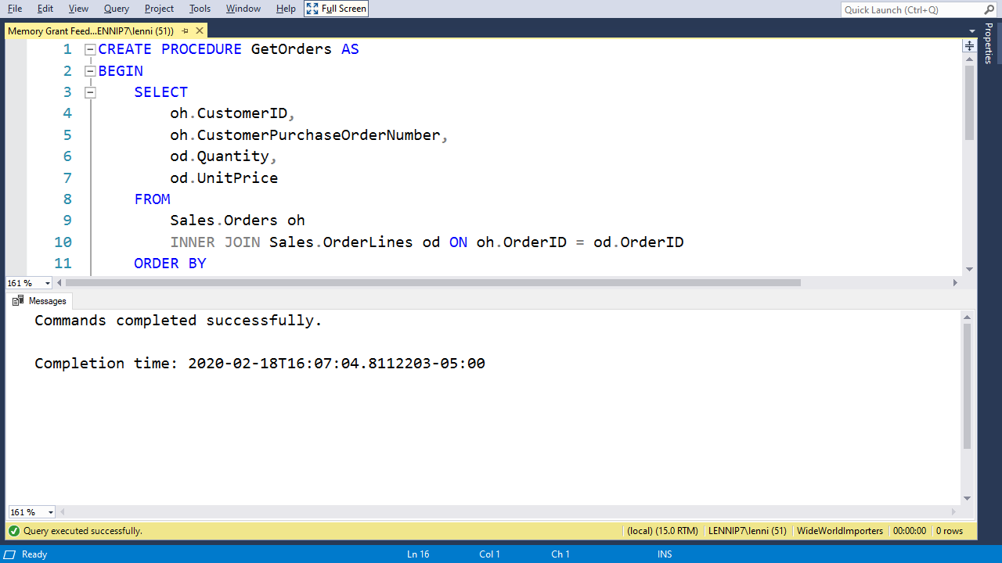

Slide 61
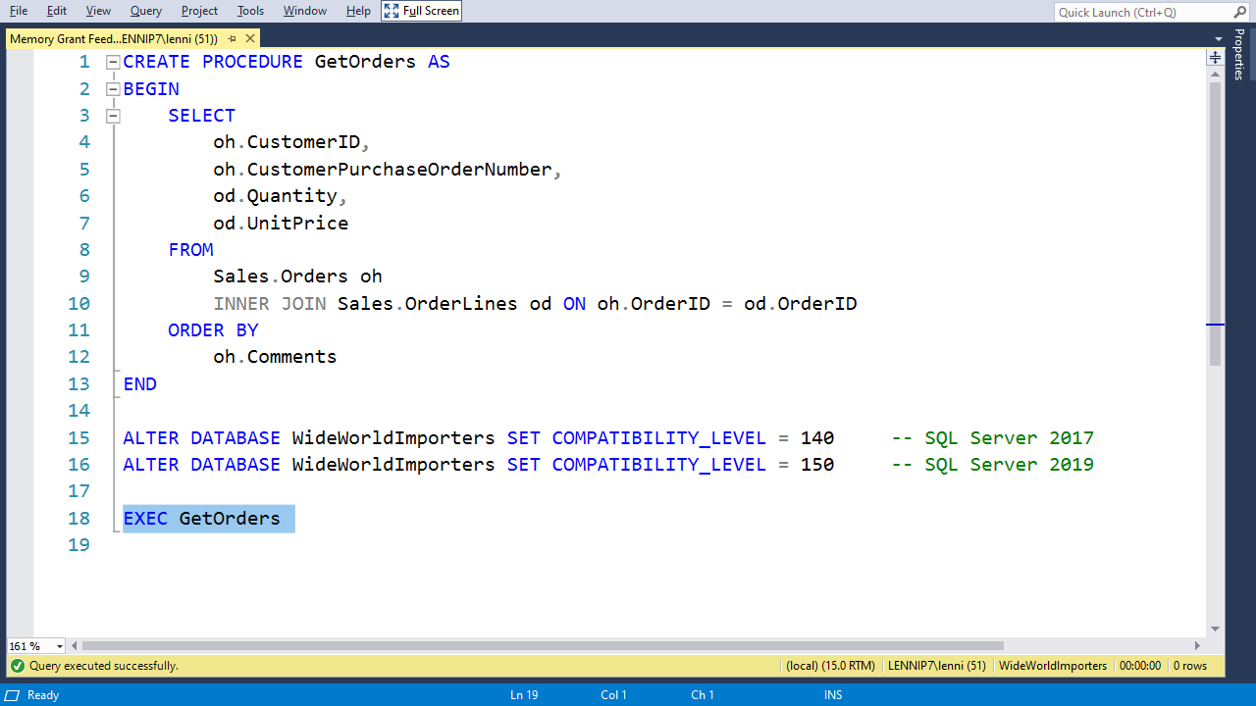

Slide 62
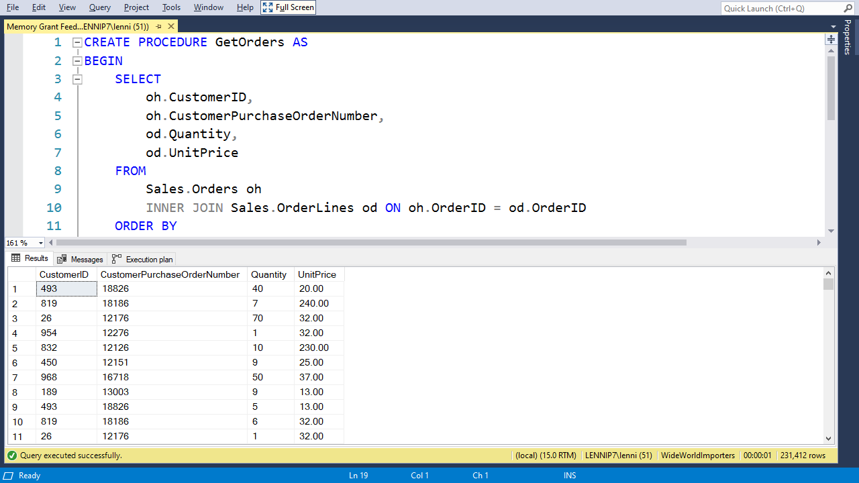

Slide 63
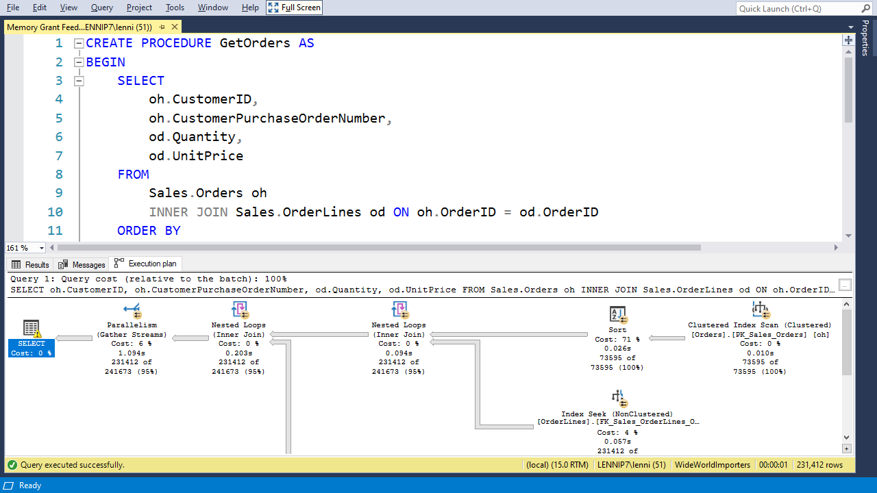

Slide 64
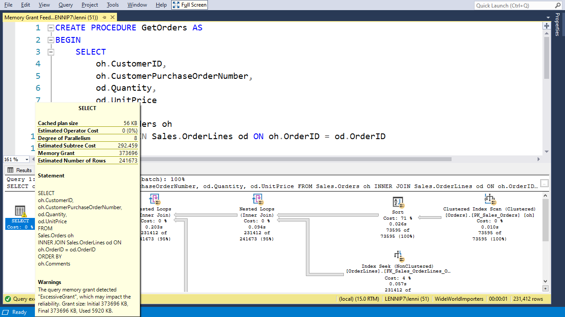

Slide 65
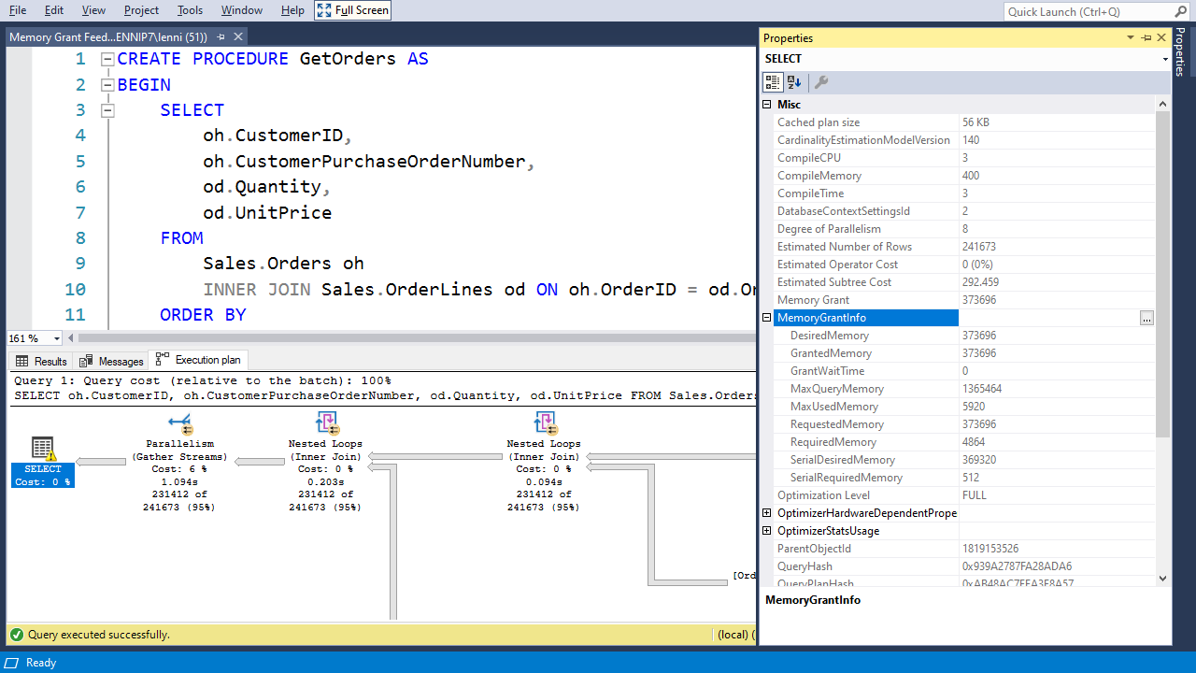

Slide 66
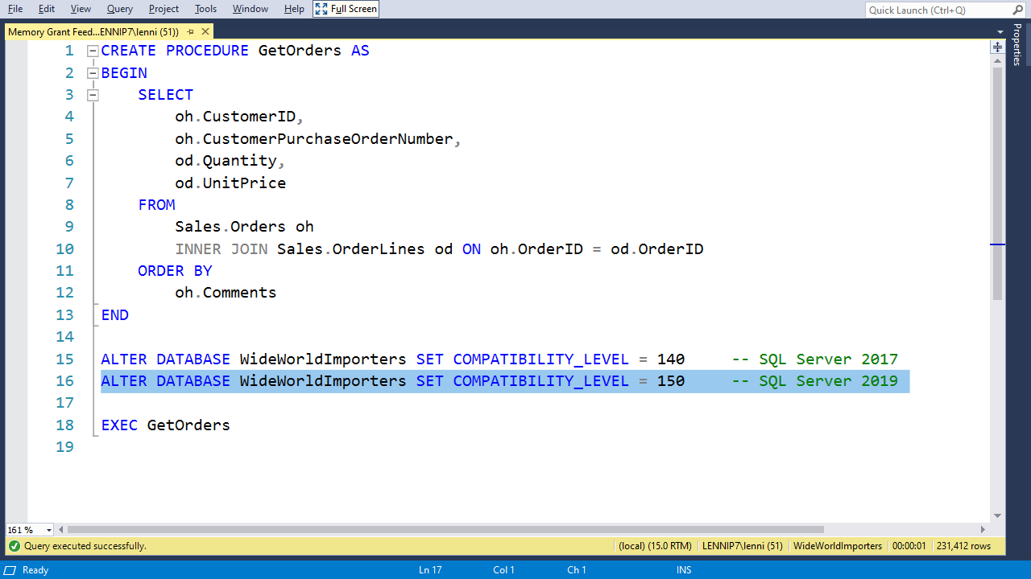

Slide 67


Slide 70
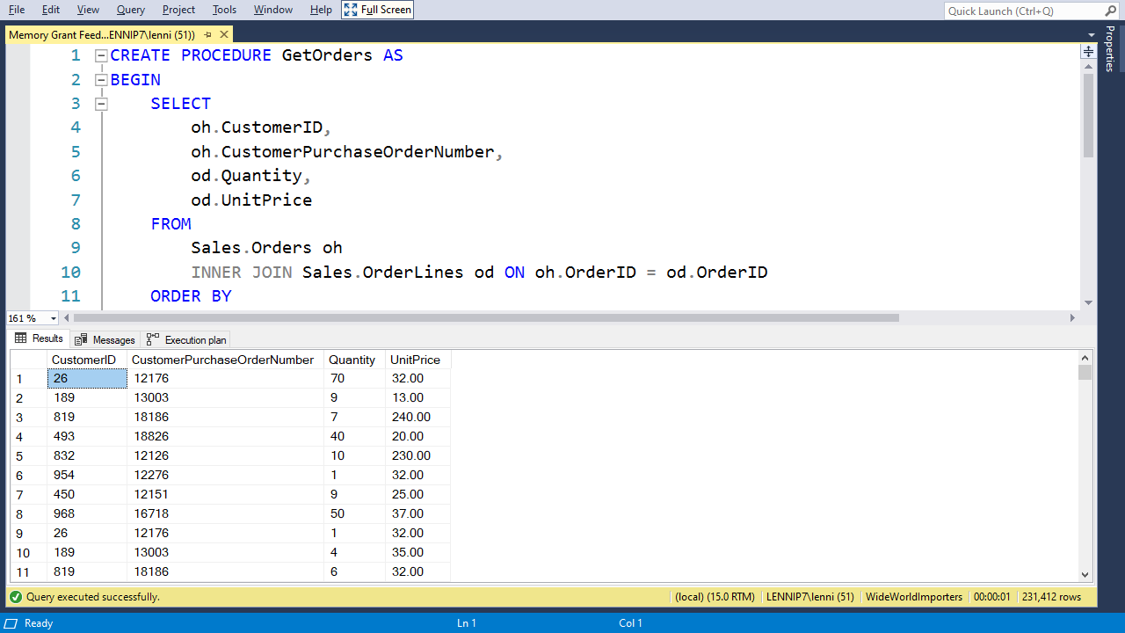

Slide 71


Slide 72
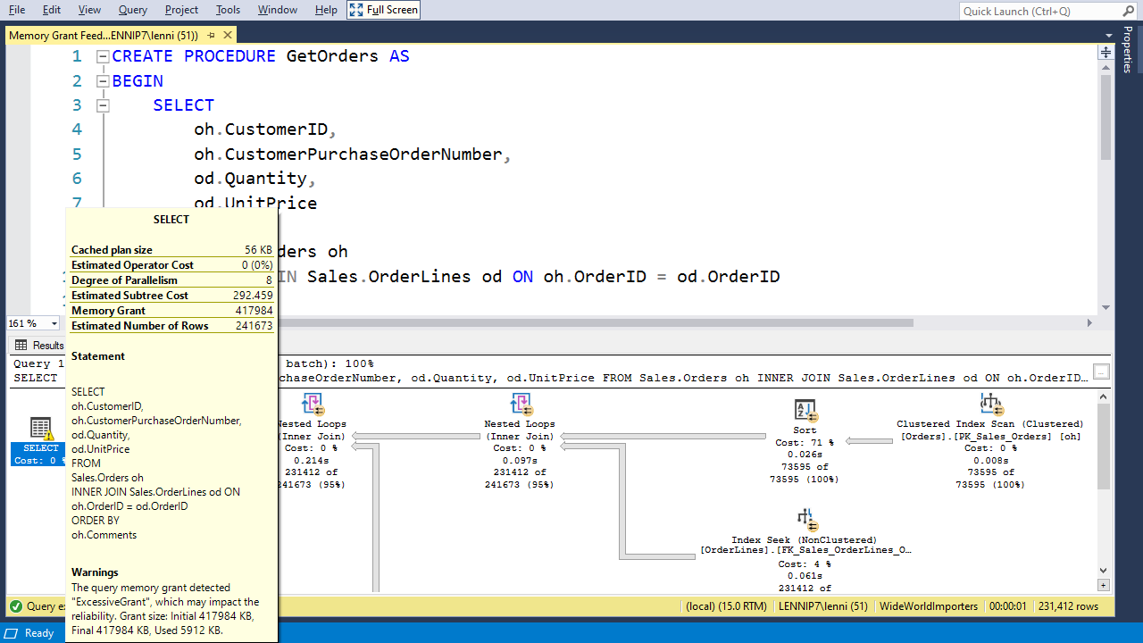

Slide 73
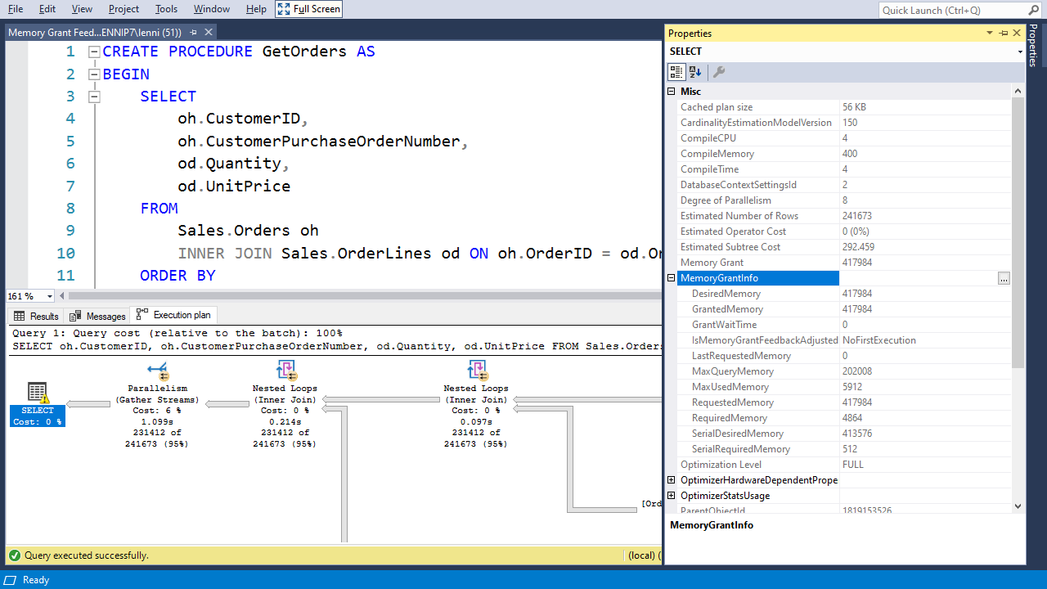

Slide 76


Slide 77


Slide 78


Slide 79
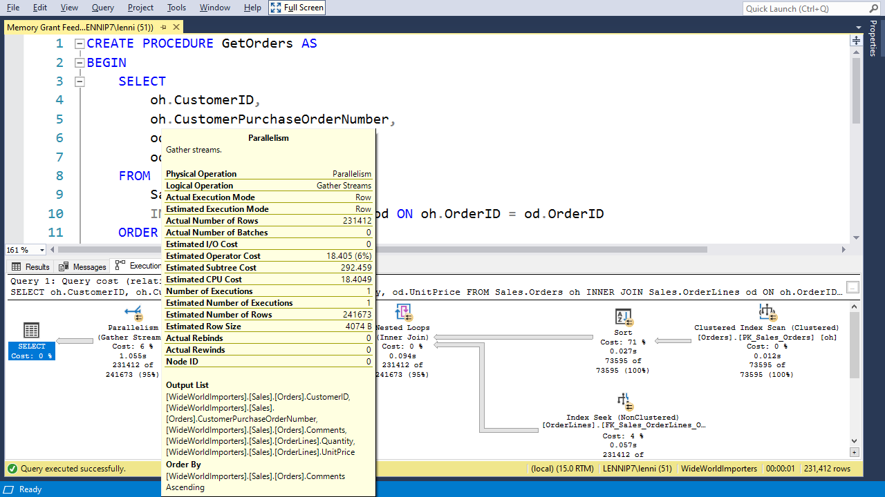

Slide 81
Batch Mode on Rowstore

Slide 82
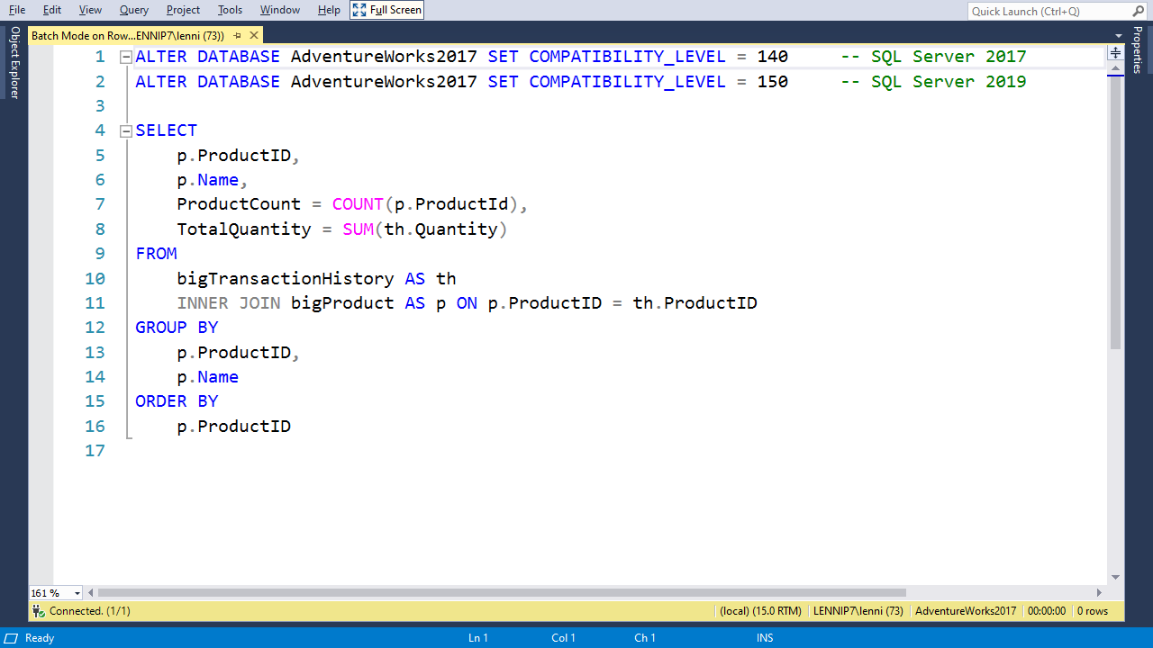

Slide 83
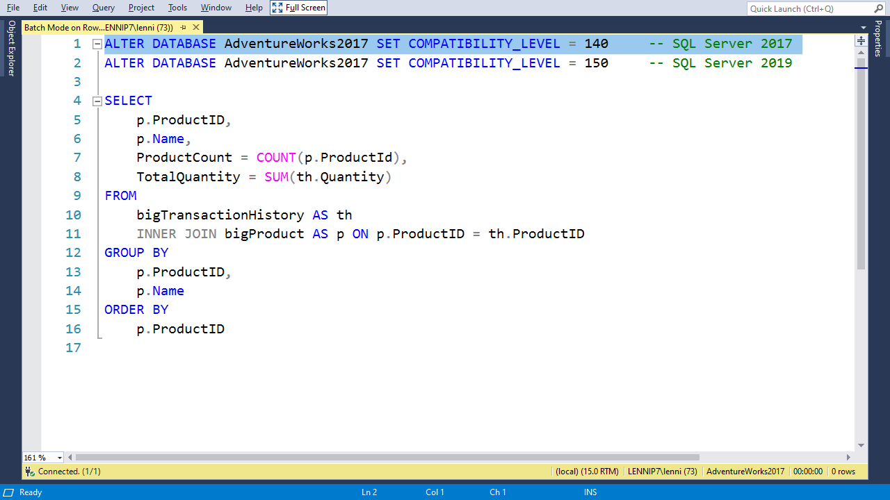

Slide 84
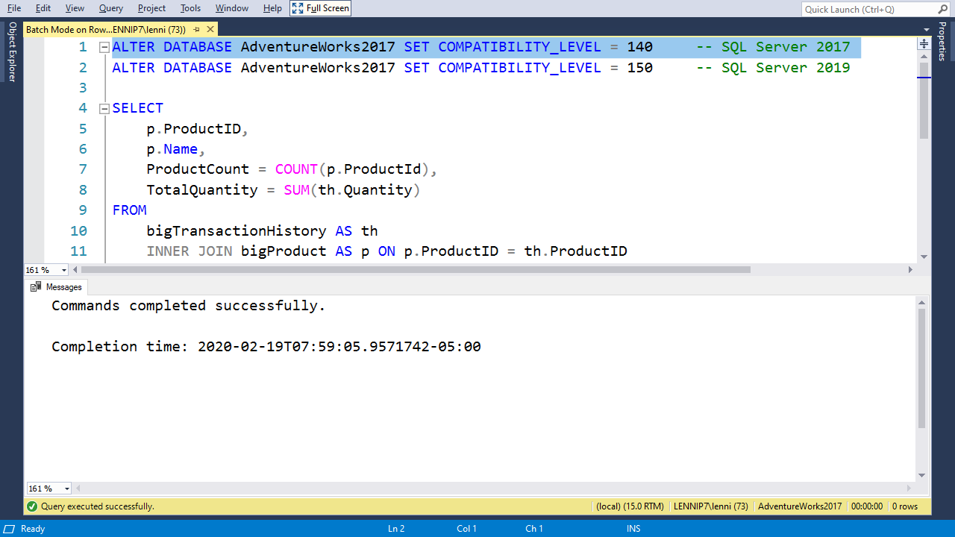

Slide 86
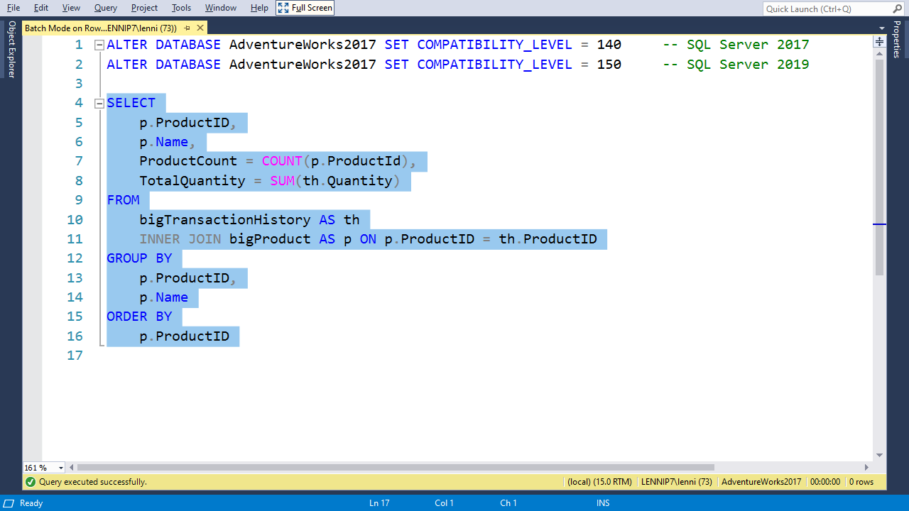

Slide 87


Slide 88


Slide 89


Slide 91


Slide 92


Slide 95


Slide 96


Slide 97


Slide 99
Table Variable Deferred Compilation

Slide 100


Slide 101


Slide 102


Slide 104


Slide 105


Slide 106


Slide 107


Slide 109


Slide 111


Slide 113


Slide 114


Slide 115


Slide 116


Slide 118


Slide 119


Slide 120


Slide 122


Slide 123
Notes:
Start slow running demo first

Slide 124
Scalar UDF Inlining

Slide 125


Slide 126


Slide 127


Slide 128


Slide 129


Slide 130


Slide 131


Slide 132


Slide 133


Slide 134


Slide 135


Slide 136


Slide 138


Slide 139


Slide 140


Slide 141


Slide 142


Slide 143


Slide 144


Slide 145


Slide 146


Slide 147


Slide 149
Approximate Count Distinct
Notes:
Use Adaptive Join demo with db compat level set to 150

Slide 150


Slide 151


Slide 152


Slide 153


Slide 154


Slide 155


Slide 156


Slide 157


Slide 158


Slide 159


Slide 160


Slide 162


Slide 163


Slide 164


Slide 165


Slide 166


